Slide 1
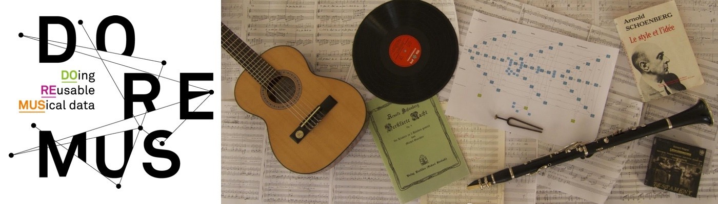

Learning material : data model
http://www.doremus.org
Editor: Jean Delahousse (delahousse.jean@gmail.com) / Niels Nicolas (niels.nicolas@ourouk.com)
Ourouk

Slide 2
Summary
Introduction
Data access
Data model overview
Data model specifics cases
Controlled vocabularies for DOREMUS
Data model UML schema
Vraies query metier

Slide 3
Introduction

Slide 4
Introduction
Target audience
This presentation of the DOREMUS model is intended for anyone who:
Describe musical resources according to the DOREMUS model
Publish musical data according to the DOREMUS model
Explore a RDF DOREMUS graph
Integrate musical data conforming DOREMUS model into applications or knowledge graphs
This presentation is intended for documentalists as for computer scientists. The two visions are presented. The collection of slides can be adapted according to the public.

Slide 5

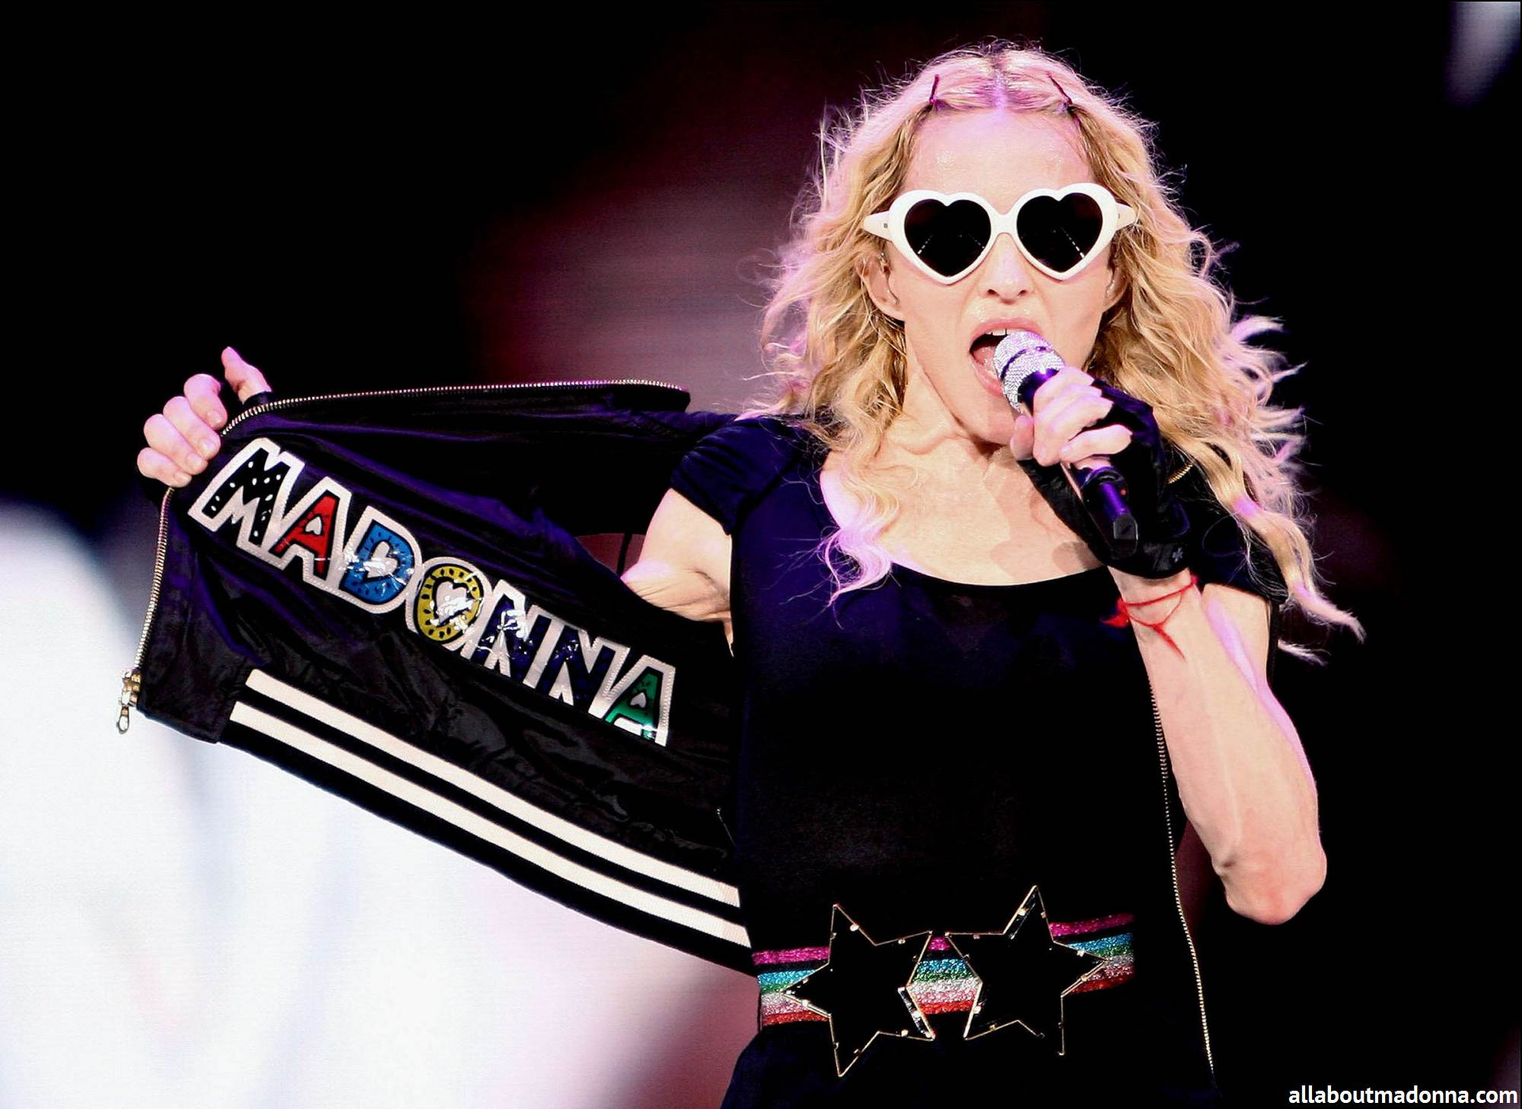
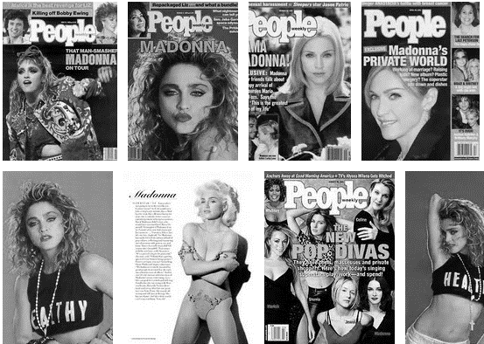
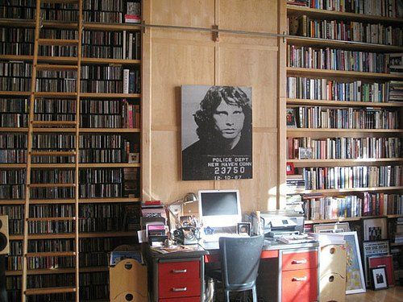
Introduction
There are multiple points of view on a same domain
« People » view
« Music librarian » view
Love stories, Gossips, News
Concerts, Albums, Works

Slide 6
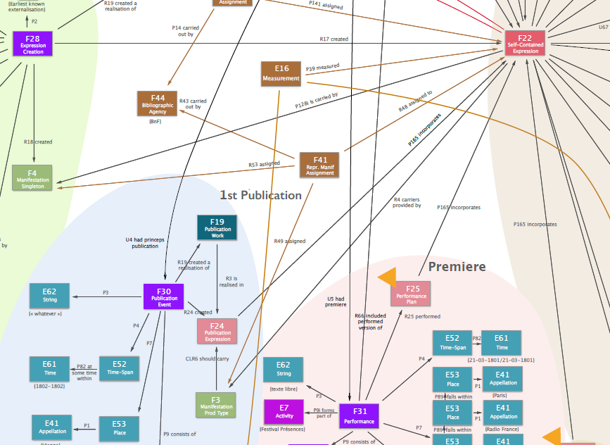
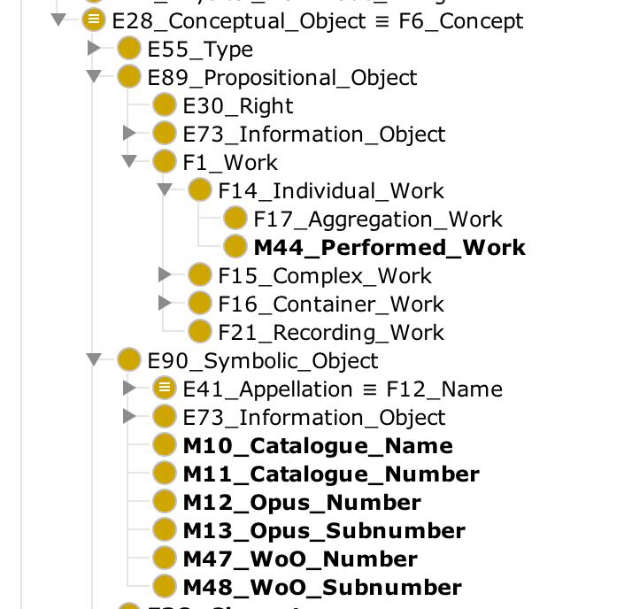
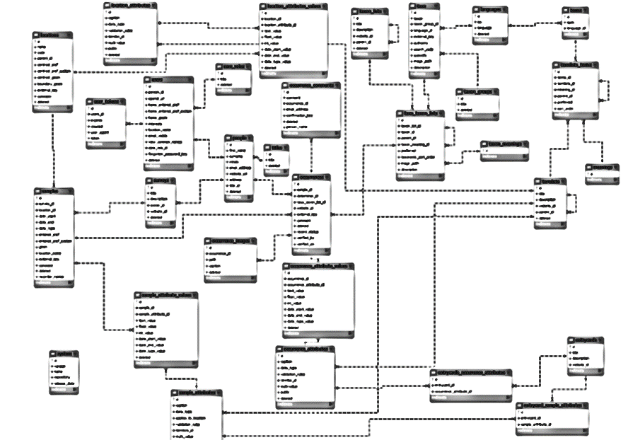
Introduction
From conceptual to data model
Ontology OWL for
RDF data representation
Entity Relation data model
DOREMUS conceptual model
A point of view shared by a community on a domain
A common approach of data
An representation independent of technical data representation

Slide 7



Introduction
DOREMUS bases
Conceptual model documentation
Ontology
http://doremus.org
Conceptual model documentation (v2.4)
Ontology
http://www.ifla.org
Conceptual model documentation (v6.2.2)
Ontology
Conceptual model documentation
FRBR
http://www.ifla.org
http://www.cidoc-crm.org

Slide 8
Data access

Slide 9
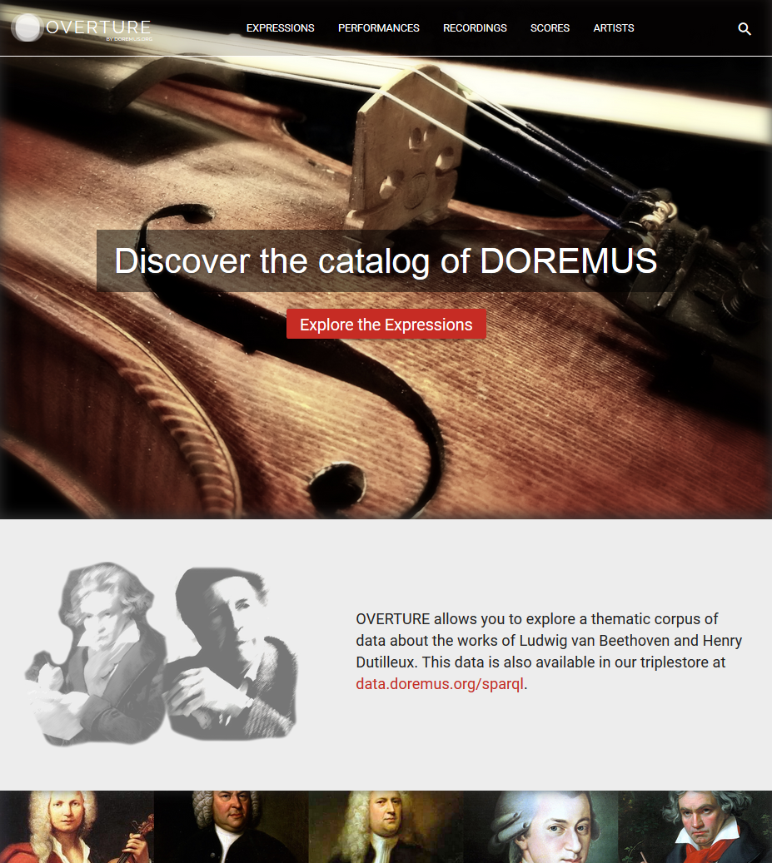

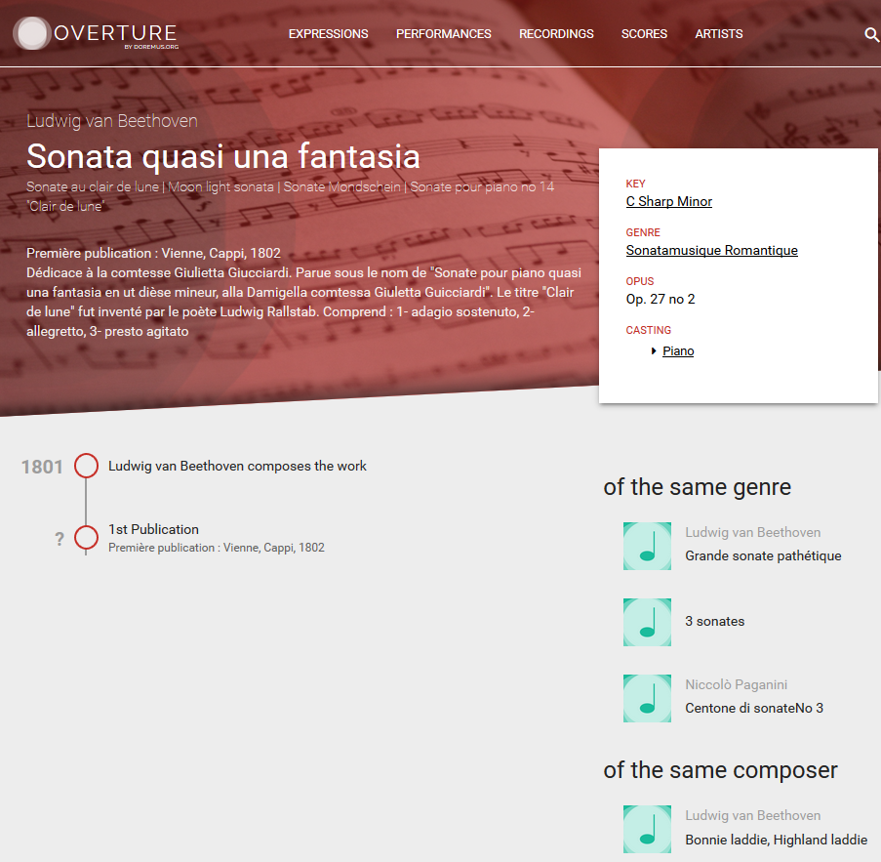


Data access
Access for humans & machines
http://data.doremus.org/sparql
http://data.doremus.org/api
https://github.com/DOREMUS-ANR/knowledge-base/tree/master/data
DUMP
http://overture.doremus.org/

Slide 10
Data model overview

Slide 11
Data model overview
Naming conventions
Classes
M = Classes Doremus
E = Classes CIDOC-CRM
F = Classes FRBRoo
Properties
U, CLU = Propriétés Doremus
P = Propriétés CIDOC-CRM
R = Propriétés FRBRoo
CLP, CLR = peuvent être des propriétés FRBRoo ou Doremus

Slide 12
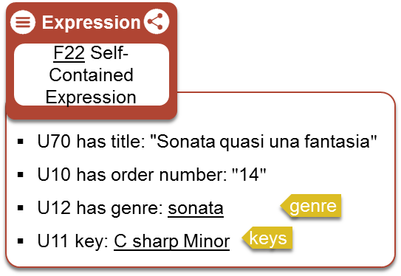
Data model overview
How to use the next slides ?
Click to visualize resource in Overture user interface
Click to visualize properties and environment of the resource in the Doremus triplestore
Click to access description of the class in Doremus documentation
Click to access description of the controlled vocabulary
Click to access concept description

Slide 13
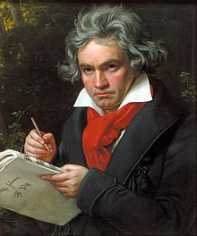
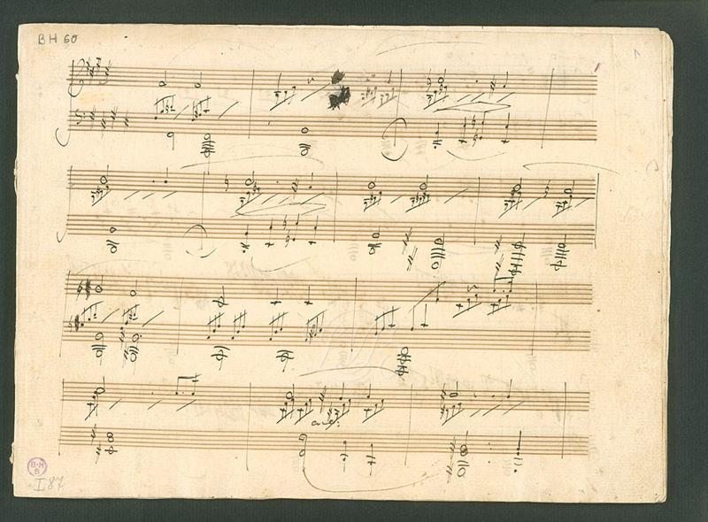
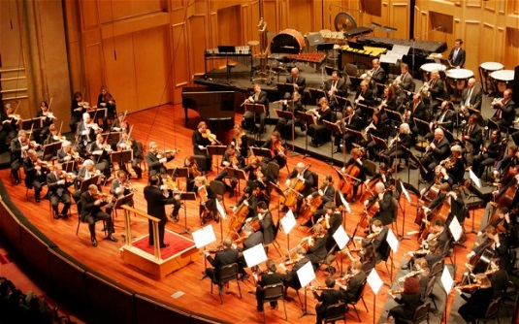
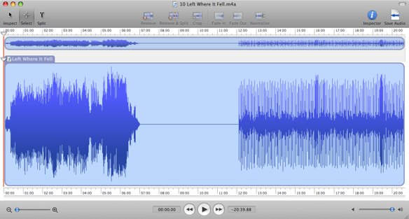
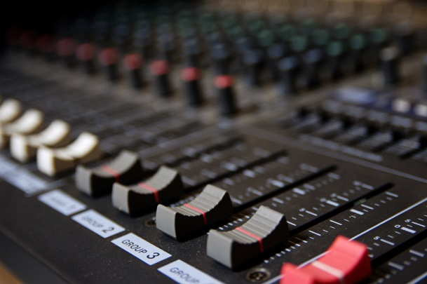
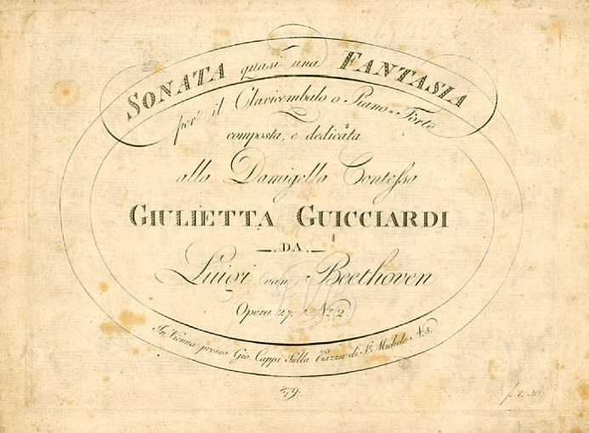
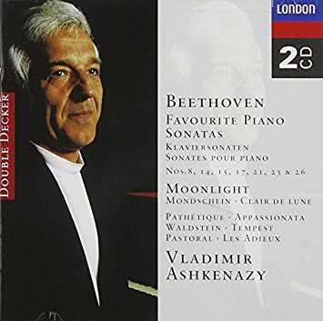
Data model overview
Timeline
1801
Composition of Sonata quasi una fantasia by Beethoven
2014
Studio Performance
2014
Editing tracks of Recording
1802
Premiere
2014
Studio Performance Recording
2015
CD publication including
« Sonata quasi una Fantasia »
1802
First publication of music score

Slide 14
Data model overview
Timeline
1801
Composition of Sonata quasi una fantasia by Beethoven
2014
Concert at Philarmonie
1802
First publication of music score
2015
CD publication including
« Sonata quasi una Fantasia »

Slide 15



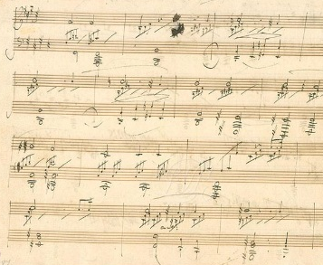
Data model overview
Musical composition
Composition of Sonata quasi una fantasia by Beethoven
Actor
Work
R40 has representative expression
E21 Person
Event
F15 Complex Work
P131 is identified by: "Ludwig van Beethoven (1870-1827)"
P198i was born: "1770-01-01"
P100i died in: "1827-01-01"
F30 Publication Event
Information
object
U23 has casting detail
Information
object
U4 had princeps
publication
R10 has member
M6 Casting
M23 Casting Detail
Work
F14 Individual Work
P3 has note: "Piano"
U2 foresees use of medium of performance of type: Piano
U30 foresees quantity of mop : 1
R19 created a realisation of
medium of performance
P14 carried out by
R9 is realised in
U13 has casting
Event
P9 consist of
Event
Expression
Appellation
E7 Activity
F28 Expression Creation
R17 created
F22 Self-Contained Expression
U17 has opus statement
M2 Opus statement
U31 had function of type: "compositeur"
U70 has title: "Sonata quasi una fantasia"
U10 has order number: "14"
U12 has genre: sonata
U11 key: C sharp Minor
U42 has opus number: "27"
U43 has opus subnumber: "2"
P3 has note: "Op. 27, no 2"
P4 has timespan
CRM entity
E52 Timespan
genre
keys
P79 beginning is qualified by: "1801-01-01"
P80 end is qualified by: "1801-12-31"
Information
object
Composition of Sonata quasi una fantasia by Beethoven
U44 has dedication statement
M15 Dedication statement
P3 has note: "Dédicace à la comtesse Giulietta Giucciardi"

Slide 16
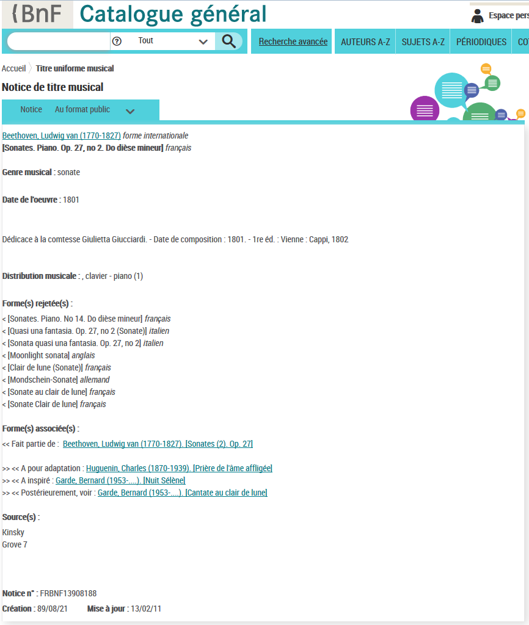
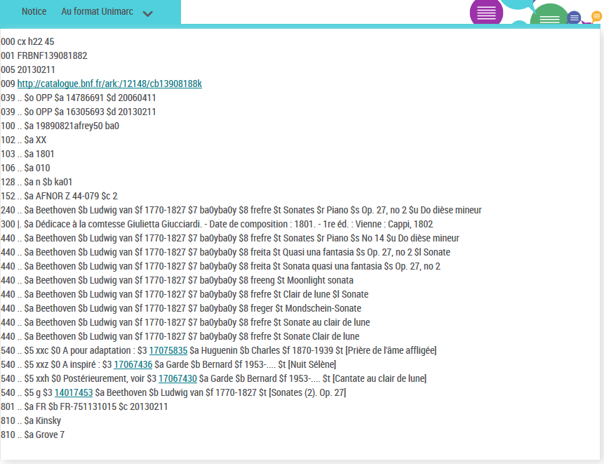
Original notice in BNF catalog
Musical composition
Access original notice in BNF catalog :
http://catalogue.bnf.fr/ark:/12148/cb13908188k.public

Slide 17
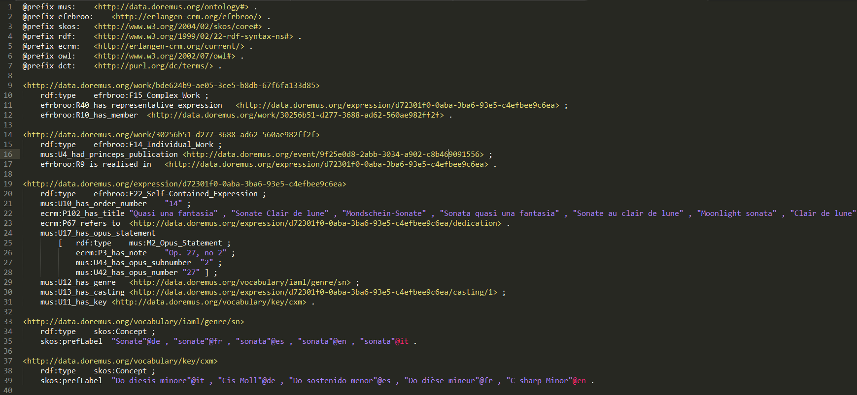
RDF graph
Musical composition 1/2
Access original file : https://drive.google.com/open?id=0BwopBdic2_jUVnNoYkpGcmRiUFU

Slide 18
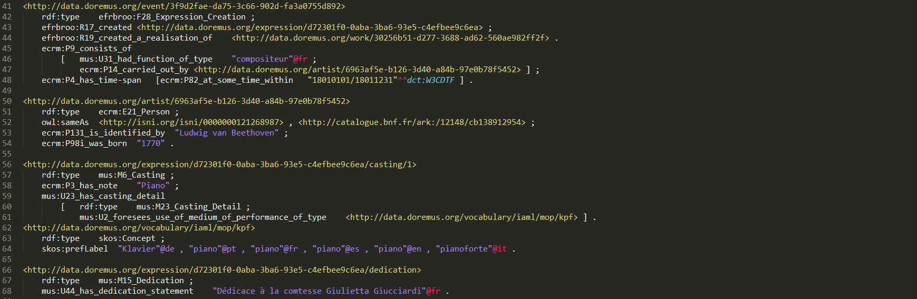
RDF graph
Musical composition 2/2
Access original file : https://drive.google.com/open?id=0BwopBdic2_jUVnNoYkpGcmRiUFU

Slide 19
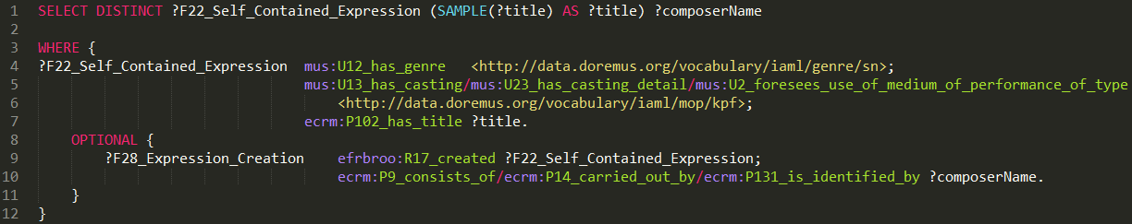
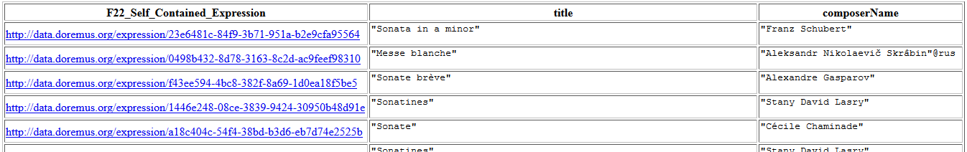
Sparql query
Musical composition
QUERY : Find all musical works of genre « sonata » composed for « piano »
Access original file : https://drive.google.com/open?id=0BwopBdic2_jUSGVPT2hrT3pLZjg
Extract of results

Slide 20
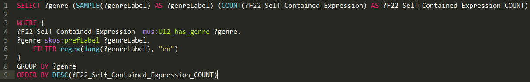
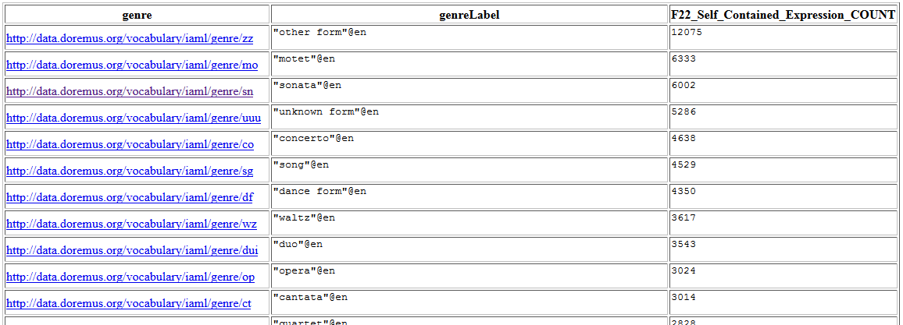
Sarql query
Musical composition
QUERY : How many musical works by genre
Access original file : https://drive.google.com/open?id=0BwopBdic2_jUczkwYTV4N2M1SjQ
Extract of results

Slide 21
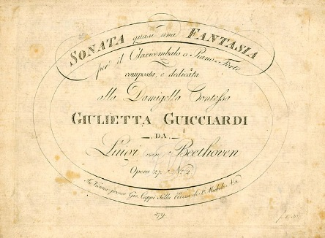
Data model overview
Music score publication
First publication of music score of Sonata quasi una fantasia
Work
R19 created a
realisation of
F19 Publication Work
Work
U4 had princeps
publication
Event
R19 created a
realisation of
F14 Individual Work
F30 Publication Event
R24 created
R3 is realised in
Event
Expression
F28 Expression Creation
R9 is realised in
P3 has note: "1re éd. : Vienne : Cappi, 1802"
P7 took place at : "Vienne"
F24 Publication Expression
Expression
R17 created
F22 Self-Contained Expression
Composition of Sonata quasi una fantasia by Beethoven
P4 has timespan
P165 incorporates
CRM entity
E52 Timespan
P79 beginning is qualified by: "1802-01-01"
P80 end is qualified by: "1802-12-31"
label: "1802"

Slide 22
Original notice in BNF catalog
Music score publication
Access original notice in BNF catalog :
http://catalogue.bnf.fr/ark:/12148/cb13908188k.public

Slide 23
RDF graph
Music score publication

Slide 24
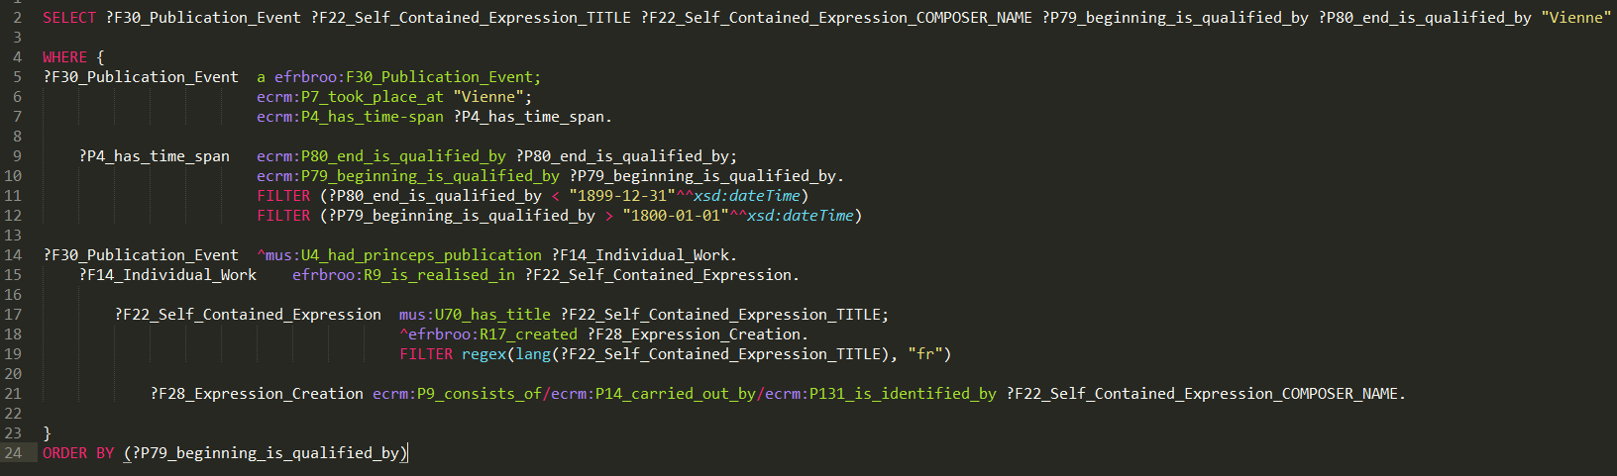
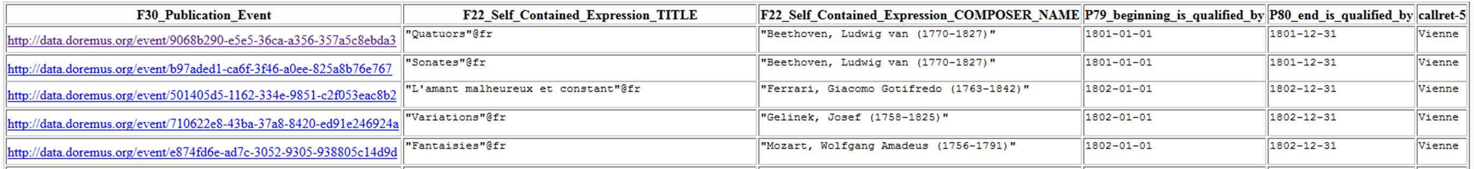
Sparql query
Music score publication
QUERY : Find all scores fisrt published in Vienna during 19th century
Access original file : https://drive.google.com/open?id=0BwopBdic2_jUN2k4SDNSU2hWWmM
Extract of results

Slide 25
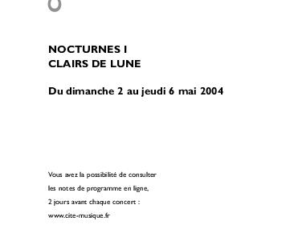
Data model overview
Concert programming
Composition of Sonata quasi una fantasia by Beethoven
Publication of concert program :
2nd to 6th May 2004
Concert Nocturne 1 Clairs de lune at Philharmonie of Paris
DRAFT
Expression
Work
F22 Self-Contained Expression
created a
realisation of
F20 Performance Work
has title: "Sonata quasi una fantasia"
has order number: "14"
has genre: sonata
key: C sharp Minor
Event
F28 Expression Creation
is realised in
genre
created
Expression
keys
F25 Performance Plan
incorporates
should perform
Event
M26 Foreseen Performance
has association with
has association with
Event
Event
M26 Foreseen Performance
M27 Foreseen Individual Performance

Slide 26
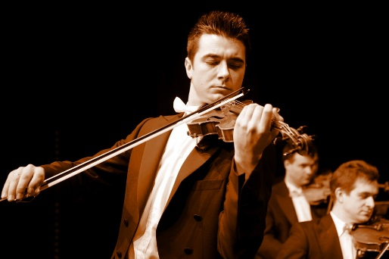
Data model overview
Musical performance
2nd May 2004
Concert Nocturne 1 Clairs de lune
at Philharmonie of Paris
Composition of Sonata quasi una fantasia by Beethoven
DRAFT
Event
F31 Performance
Expression
F22 Self-Contained Expression
consist of
has title: "Sonata quasi una fantasia"
has order number: "14"
has genre: sonata
key: C sharp Minor
created a
realisation of
Work
M44 Performed Work
Event
genre
M42 Performed Expression Creation
is realised in
keys
Expression
created
M43 Performed Expression
is performed expression of
consist of
consist of
Event
Event
F31 Performance
M28 Individual Performance

Slide 27
Data model overview
Performance recording
DRAFT
Recording of Concert Nocturne 1 Clairs de lune. May 2nd 2004. Philharmonie of Paris
2nd May 2004
Concert Nocturne 1 Clairs de lune
at Philharmonie of Paris
created a
realisation of
Work
F21 Recording Work
Event
recorded
Event
F31 Performance
F29 Recording Event
is realised in
created
Expression
F26 Recording

Slide 28
Data model overview
Editing tracks
DRAFT
Recording of Concert Nocturne 1 Clairs de lune. May 2nd 2004. Philharmonie of Paris
Editing tracks of Recording of Concert Nocturne 1 Clairs de lune. May 2nd 2004. Philharmonie of Paris
Expression
Event
Expression
F26 Recording
M29 Editing
created
M46 Set of Tracks
edited
2nd May 2004
Concert Nocturne 1 Clairs de lune
at Philharmonie of Paris
created
has component
has component
Expression
Expression
Expression
M24 Track
M24 Track
is partial of full recording of
M43 Performed Expression
Manifestation
F4 Manifestation Singleton

Slide 29
Data model overview
CD publication

Slide 30
Data model specifics cases

Slide 31
Data model specifics cases
Alternative casting

Slide 32
Data model specifics cases
Track with or without knowned composer

Slide 33
Data model specifics cases
Inter musical works relationships

Slide 34
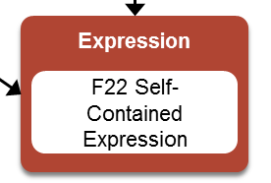
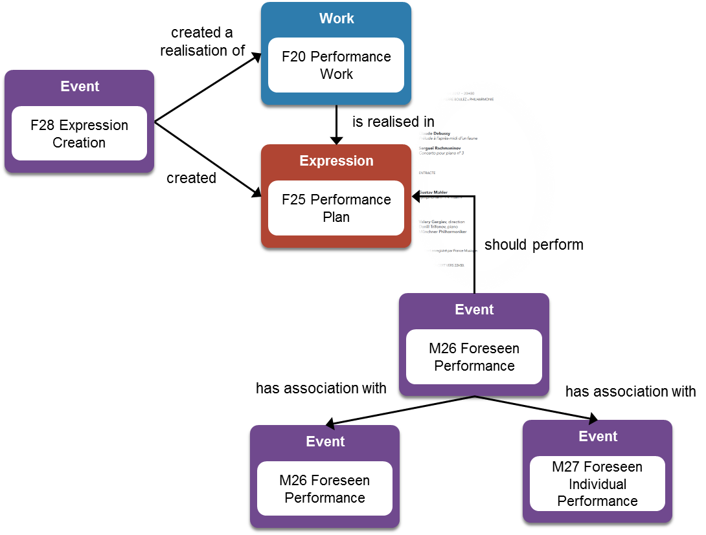
Data model specifics cases
2nd May 2004
Concert Nocturne 1 Clairs de lune
at Philharmonie of Paris
Musical performance with « mise-en-scène »
Work
Composition of Sonata quasi una fantasia by Beethoven
F15 Complex Work
DRAFT
has member
has member
created a
realisation of
Work
F20 Performance Work
Event
F28 Expression Creation
is realised in
created
Expression
F25 Performance Plan
performed
incorporates
Event
F31 Performance
consist of
consist of
Event
Event
F31 Performance
M28 Individual Performance
Program: Concert Nocturne 1 Clairs de lune. From May 2nd to May 6th 2004. Philharmonie of Paris
{Concert Nocturne 1 Clairs de lune. May 2nd 2004. Philharmonie of Paris}
34

Slide 35
Controlled vocabularies

Slide 36

Controlled vocabularies
Overview
Controlled vocabularies
Work
Type
F1 Work ?
M9 Derivation Type
derivation
U47 has derivation type
Work
Appelation
U40 has catalogue name
Type
F14 Individual Work
M1 Catalogue Statement
M10 Catalogue Name
catalogue
Event
U16 has catalogue statement
F28 Expression Creation
Type
Expression
M4 Key
key
F22 Self-Contained Expression
U11 has key
Type
U12 has genre
M5 Genre
genre
Event
U1 use medium of performance
M28 Individual Performance
Type
M14 Medium Of Performance
medium of performance
Information
object
M23 Casting Detail
U2 foresees use of medium of performance of type

Slide 37

Controlled vocabularies
List of keys
Summary description
URI | http://data.doremus.org/vocabulary/key/
Title | List of keys
Creator | doremus.org
Description | The sum of relations, melodic and harmonic, existing between the tones of a scale or musical system
Created | 2016-09-01
Conforms | SKOS
License
Language | English, French, Deutsch, Italian, Spanish
DOREMUS usages | Equivalent class: M4 Key Used for: U11 key (in class F22 Self-Contained Expression)
Some english values label
D Minor D flat Major D Major E flat Minor F sharp Major E Major E Minor A Major C flat Major …
Alignment
IFLA | Key of musical work http://iflastandards.info/ns/unimarc/terms/key#
Distribution
SPARQL | http://data.doremus.org/sparql
CSV | À préciser
RDF | À préciser

Slide 38
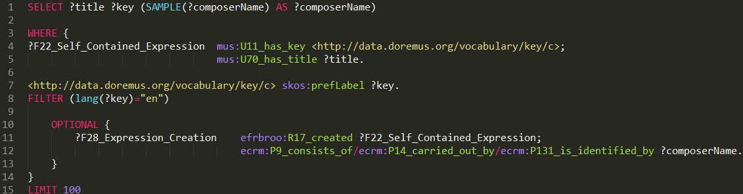
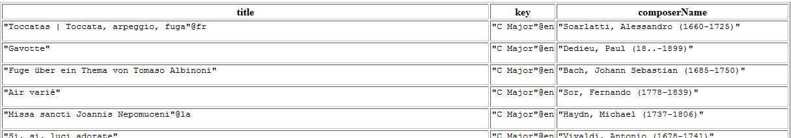
Controlled vocabularies
List of keys
QUERY : Find all musical works in C sharp Minor
Access original file : https://drive.google.com/open?id=0BwopBdic2_jUSGVPT2hrT3pLZjg
Extract of results
38

Slide 39
Controlled vocabularies
List of types of derivation
Summary description
URI | http://data.doremus.org/vocabulary/derivation/
Title | List of types of derivation
Creator | doremus.org
Description | List of derivation links between two works
Created | 2016-09-01
Conforms | SKOS
License
Language | English, French, Deutsch, Italian, Spanish
DOREMUS usages | Equivalent class: M9 Derivation Type Used for: U47 has derivation type (class E89 Propositional Object)
Some english values label
Fantasy Orchestration Reharmonization Transcription Variation Reconstruction Harmonization Medley Reorchestration …
Alignment
Distribution
SPARQL | http://data.doremus.org/sparql
CSV | À préciser
RDF | À préciser

Slide 40
Controlled vocabularies
List of types of derivation
QUERY :
Access original file : https://drive.google.com/open?id=0BwopBdic2_jUSGVPT2hrT3pLZjg
Extract of results
40

Slide 41
Controlled vocabularies
List of modes
Summary description
URI | http://data.doremus.org/vocabulary/mode/
Title | List of modes
Creator | doremus.org
Description | Mode generally refers to a type of scale, coupled with a set of characteristic melodic behaviours
Created | 2016-09-01
Conforms | SKOS
License
Language | English, French
DOREMUS usages | Equivalent class: M22 Mode À préciser Used for: U22 has mode (class F22 Self-Contained Expression) À préciser
Some english values label
modern musical scales dorian mode mixolydian mode … western church modes lydian mode aeolian mode … …
Alignment
Distribution
SPARQL | http://data.doremus.org/sparql
CSV | À préciser
RDF | À préciser

Slide 42
Controlled vocabularies
List of modes
QUERY :
Access original file : https://drive.google.com/open?id=0BwopBdic2_jUSGVPT2hrT3pLZjg
Extract of results
42

Slide 43
Controlled vocabularies
List of genres
Summary description
URI | http://data.doremus.org/vocabulary/iaml/genre/
Title | List of musical genres
Creator | iaml.info
Description | À préciser
Created | À préciser
Conforms | SKOS
License | À préciser
Language | English, French, Deutsch, Italian
DOREMUS usages | Equivalent class: M5 Genre Used for: U12 has genre (class F22 Self-Contained Expression)
Some english values label
byzantine canon children's song foxtrot fugue folie forlana galop hard rock …
Alignment
IFLA | The form of a musical work http://iflastandards.info/ns/unimarc/terms/fom/
BNF | Rameau À préciser
Distribution
SPARQL | http://data.doremus.org/sparql
CSV | À préciser
RDF | À préciser

Slide 44


Controlled vocabularies
Use of genres in DOREMUS datasets
Datasets
Genre vocabularies
DRAFT
Est-ce que le Dataset DOREMUS est publié avec le dataset IAML ?
IAML Genre vocabularies
BNF
Philarmonie
In Doremus dataset you can find local genre vocabularies aligned with IAML genre vocabulary
Radio France

Slide 45
Controlled vocabularies
List of genres
QUERY :
Extract of results
45

Slide 46
Data model UML schema

Slide 47
Data model UML schema
Composition of Sonata quasi una fantasia by Beethoven
First publication of music score of Sonata quasi una fantasia
DRAFT
Actor
Work
E21 Person
F15 Complex Work
has representative expression
Event
Information
object
has casting detail
Information
object
F30 Publication Event
had princeps
publication
has member
M6 Casting
M23 Casting Detail
Work
F14 Individual Work
created a
realisation of
carried out by
is realised in
has casting
Event
consist of
Event
Expression
Appellation
E7 Activity
F28 Expression Creation
created
F22 Self-Contained Expression
has opus statement
M2 Opus statement
has timespan
CRM entity
refers to
E52 Timespan
Information
object
M15 Dedication

Slide 48
Data model UML schema
DRAFT
created a
realisation of
Work
F20 Performance Work
Event
F28 Expression Creation
is realised in
created
Expression
F25 Performance Plan
incorporates
should perform
Event
M26 Foreseen Performance
has association with
has association with
Event
Event
M26 Foreseen Performance
M27 Foreseen Individual Performance

Slide 49
ANNEXES DE TRAVAIL

Slide 50
Questions
Validons-nous que la classe Work doit être représentée ?
Quel modèle utiliser pour les performances ? Celui basé sur « Performance Plan » ou celui basé sur « Performance Expression » ?
Peut-on avoir l’identifiant de la notice d’origine dans la publication RDF ?
Préférez-vous que l’on indique les numéros des propriétés ?
Comment renvoyer vers les documentations des classes pour les modèles FRBRoo et Cidoc CRM ?
Quel concert avec un recording ? Et idéalement un CD ?

Slide 51
Resources
http://data.doremus.org/expression/d72301f0-0aba-3ba6-93e5-c4efbee9c6ea (BNF Opus 27 n°2) / URI de la partition : http://data.doremus.org/describe/?url=http%3A%2F%2Fdata.doremus.org%2Fpublication%2Fd85fd2e1-d36c-3395-9edb-24934f629396
URI notice catalogue général : http://catalogue.bnf.fr/ark:/12148/cb13908188k
http://overture.doremus.org/expression/d72301f0-0aba-3ba6-93e5-c4efbee9c6ea
http://data.doremus.org/expression/37932fbc-fef3-3edb-9fae-1eec9b4be01d (Philarmonie Opus 27 n°2)
http://overture.doremus.org/expression/37932fbc-fef3-3edb-9fae-1eec9b4be01d

Slide 52
Getting started
Naming conventions
M = Classes Doremus
U, CLU = Propriétés Doremus
E = Classes CIDOC-CRM
P = Propriétés CIDOC-CRM
F = Classes FRBRoo
R = Propriétés FRBRoo
CLP, CLR = peuvent être des propriétés FRBRoo ou Doremus

Slide 53
Getting started
How to use the next slides ?
Click to visualize properties and environment of the resource in the Doremus triplestore (http://data.doremus.org/sparql)
DEFINE sql:describe-mode "SCBD"
DESCRIBE url de la ressource
WHERE{}
Appellation
M2 Opus statement
Click to access description of the class in Doremus documentation
Expression
F22 Self-Contained Expression
has title: "Sonata quasi una fantasia"
has order number: "14"
has genre: sonata
key: C sharp Minor
Click to access description of the controlled vocabulary in the Doremus triplestore
DEFINE sql:describe-mode "CBD"
DESCRIBE url de la ressource
WHERE{}
genre
keys
Click to access concept description in the Doremus triplestore
DEFINE sql:describe-mode "CBD"
DESCRIBE url de la ressource
WHERE{}

Slide 54
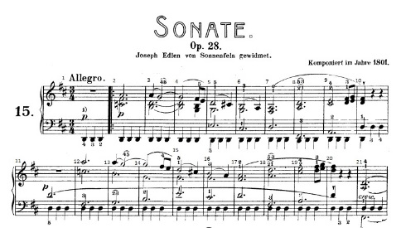
Data model overview
Timeline
Premiere
1801
Composition of Sonata quasi una fantasia by Beethoven
2nd May 2004
Concert Nocturne 1 Clairs de lune
at Philharmonie of Paris
Editing tracks of Recording of Concert Nocturne 1 Clairs de lune. May 2nd 2004. Philharmonie of Paris
1802
First publication of music score
2nd May 2004
Recording of Concert Nocturne 1 Clairs de lune. May 2nd 2004. Philharmonie of Paris
2010
CD publication including
« Sonata quasi una Fantasia »
2003 ??
Publication of concert program :
2nd to 6th May 2004
Concert Nocturne 1 Clairs de lune
at Philharmonie of Paris
Programme de salle

Slide 55
A faire
Mettre à jour la description du ConceptScheme en fonction de nos fiches
Changer Comment => Decription pour ConceptScheme
Mettre les dumps des fichiers dans un Github (not. vocabulaires contrôlés)

